Slide 1
Second Part
Introduction
CN4119 Final Year Design Project
Dr Suraj Vasudevan
E4 06-03
Email: chesura@nus.edu.sg
Microsoft Teams Chat Messages
Zoom/F2F Consultation

Slide 2
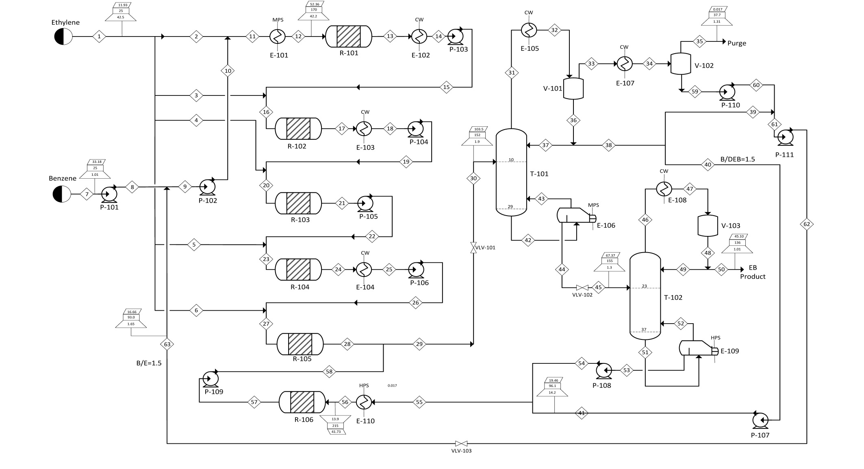
PFD of Ethyl Benzene Process
Thermodynamic Model Selection
Process Synthesis and Design
Reaction Section Design
Separation Section Design
Costing and Economics
Heat Exchanger Design and Heat Integration
Knowledge from Chemical Engineering Thermodynamics, Reaction Engineering, Mass Transfer and Separation Processes, etc.

Slide 3
Scope/Learning Outcomes
  What you have learnt
  Develop process flow diagrams (PFDs), selection and sequencing of equipment for common unit operations, reactor design, steps and considerations in process design
  What you will learn
      Cost estimation and economic analysis, basic process optimization, basic heat integration
      Industrial hazards, control measures, green chemistry, life cycle analysis

Slide 4
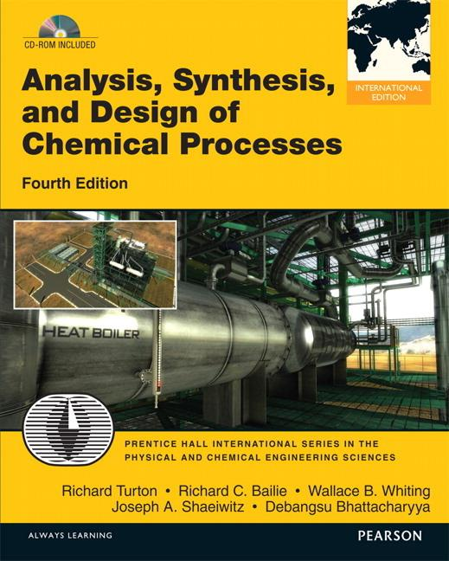
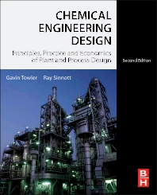

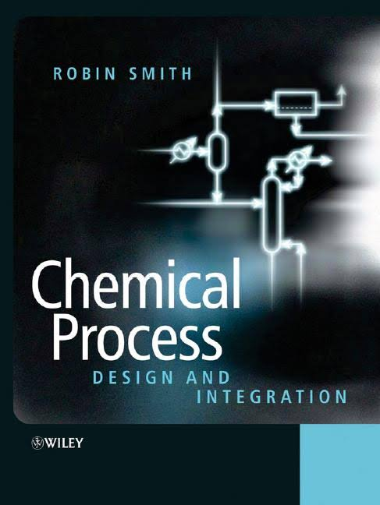
Some of Your Go-To Resources for FYDP☺!
Chapter 6: Process Design Heuristics
One more good text book!
Chapter 11: Technical Heuristics
Your main reference for this course!

